Slide 1
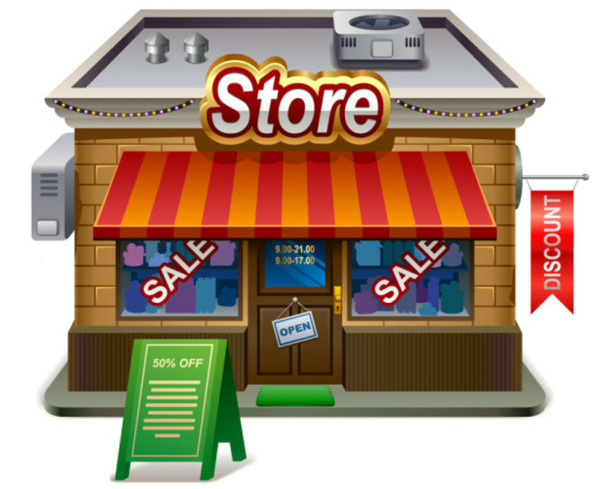
Effect of relocating products on revenue of a store.
Professor: Dr. Alice Smith
Course: Data Mining
Presenter: Mohammad Maydanchi

Slide 2
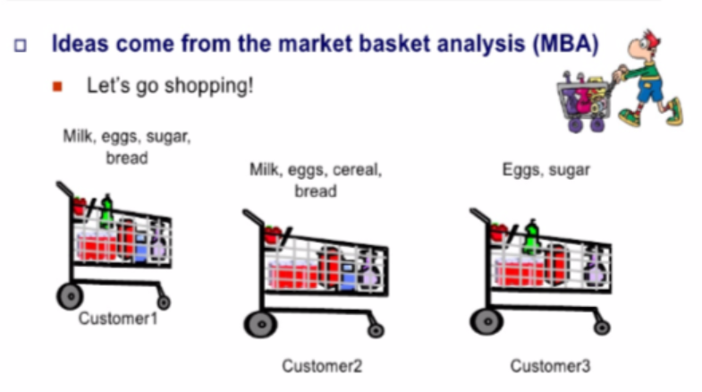
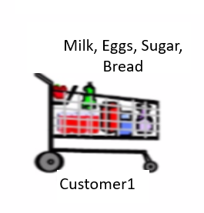

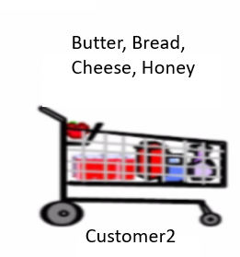
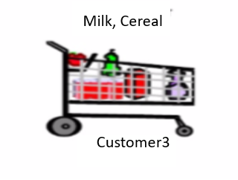






Introduction To Association Rule(AR):
Ideas come from the market basket analysis.
Milk, Eggs, Sugar, Bread
Butter, Bread, Cheese, Honey
Milk, Cereal
Customer1
Find associations and correlations between different items that customers place in their shopping basket.
Customer2
Customer3
1- What do my customer buy?
Goal
Manager
2- Which products are bought together?

Slide 3
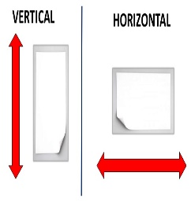
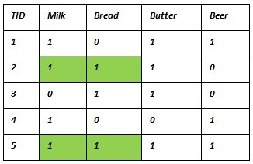
Association Rule Techniques:
1- A priori
2- Equivalent Class Transformation (Eclat)
3- Frequent Pattern(FP)-growth:

Slide 4
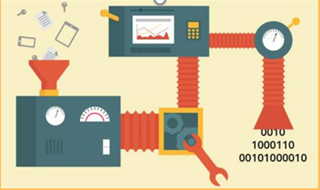
What is A priori?
Definition:
A priori, Latin for "from the former", a priori knowledge is knowledge that comes from the power of reasoning based on self-evident truths.
A priori is proper for boolean datasets.

Slide 5

A priori’s Parameters
1-support
2-confidence
3-lift

Slide 6
A priori algorithm
Step1
Set a minimum support and confidence
Step2
Take all the subsets in transactions having higher support than minimum support.
Step3
Take all the rules of this subsets having higher confidence than minimum confidence.
Step4
Sort the rules by decreasing lift
Step5
Check whether rules are reasonable or not and extract the rational ones.

Slide 7

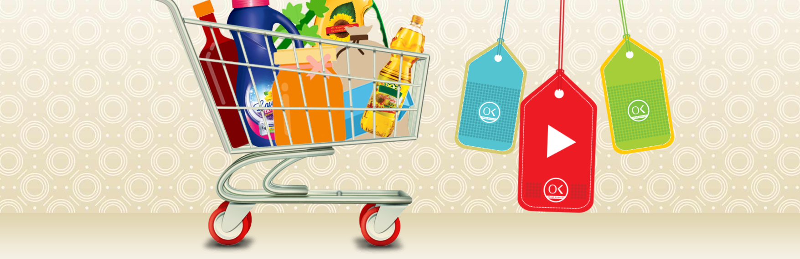
Ofogh Koorosh:

Slide 8
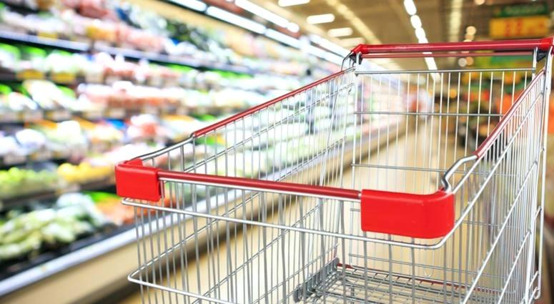
Dataset:
1-Size of Data:7501 Transactions
2-Variations:120 different products in 21 categories
3-Time of Collecting the Data: one week (May/2/2017-May/8/2017 )

Slide 9
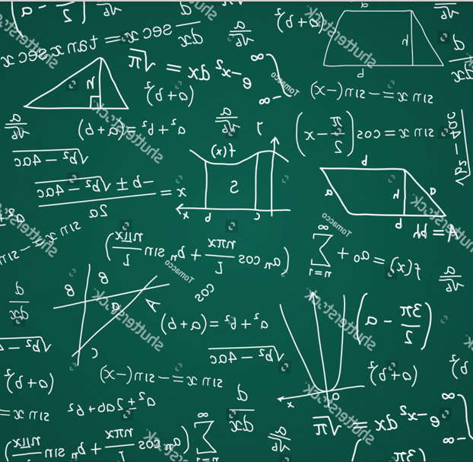

Set Parameters:
Support:
F= Frequency in a day
D= Duration of collecting the data
N=Size of data set
Minimum Support= $\frac{F∗D}{N}$ = $\frac{3∗7}{7501}$ =
Confidence:
Start with default value(0.8) then decrease confidence step by step until we get some relevant rules.
Lift:
The rules with highest lifts are most relevant rules.
0.0028
0.4

Slide 10
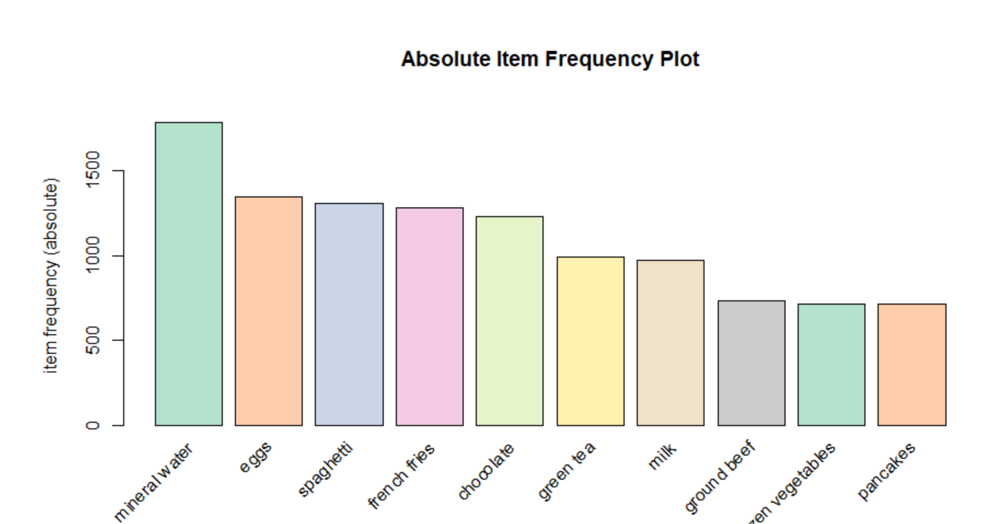
Absolute Item Frequency Plot

Slide 11
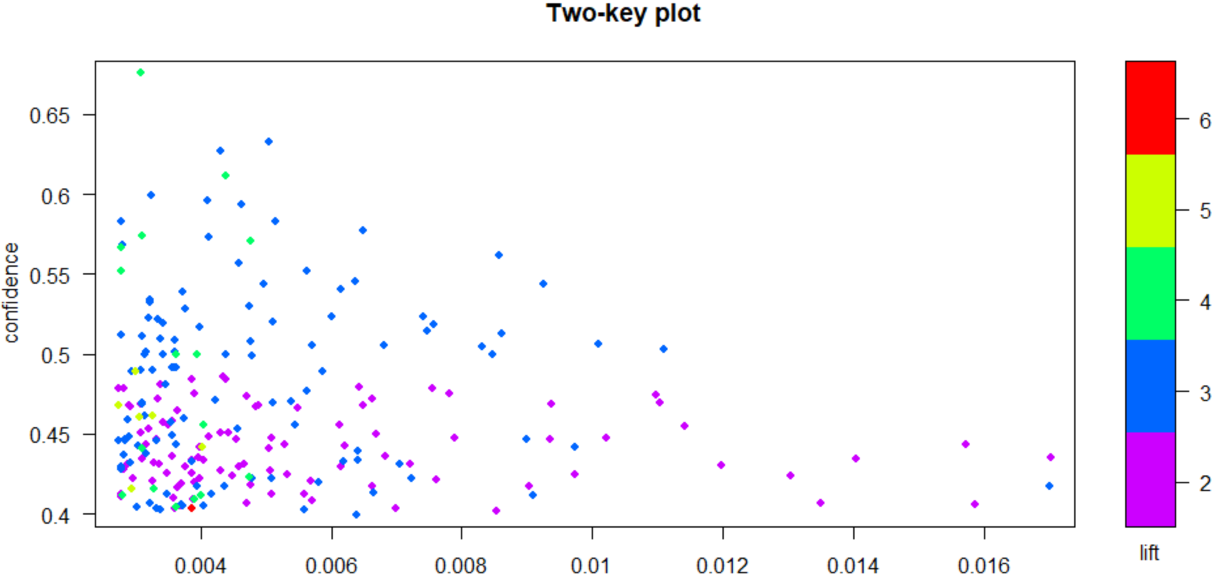
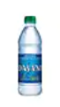
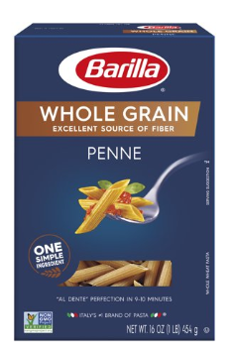
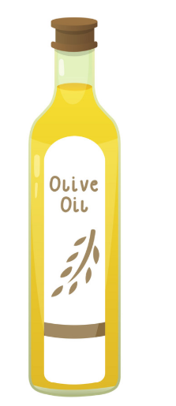
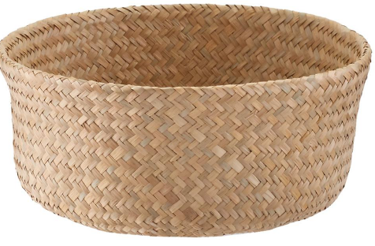
Two-Key Plot
support
+

Slide 12
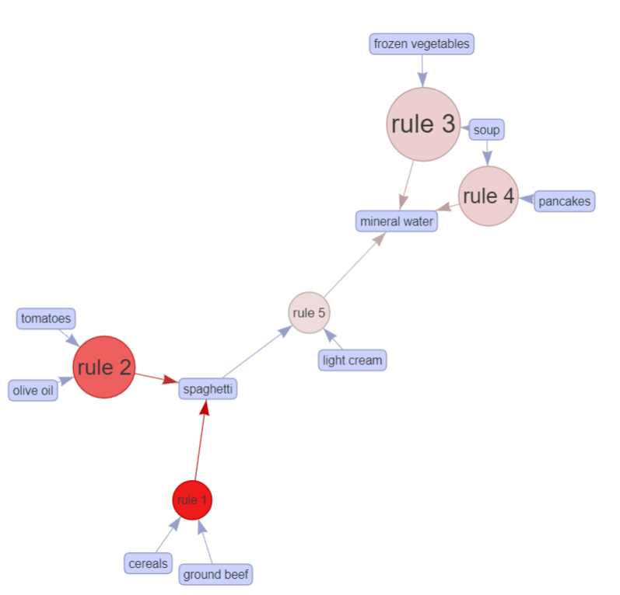
Set number of items in a basket:
GraphGraph Plot
From this step we work on a basket with 3 items (3-itemset)
With graph plots we can see the relations of the first 5 strong rules together.

Slide 13
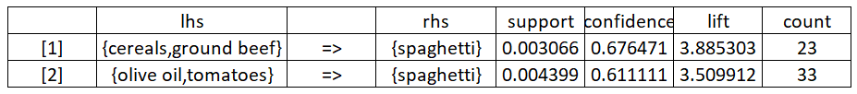
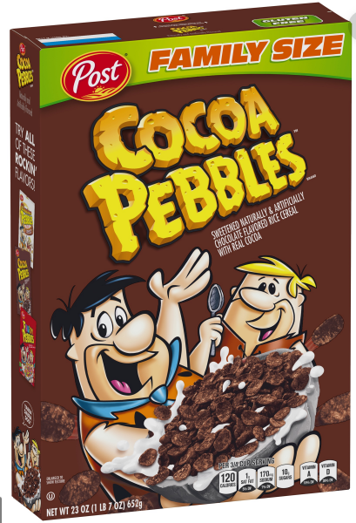
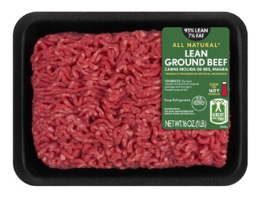
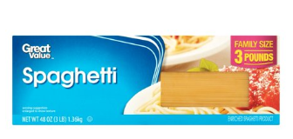
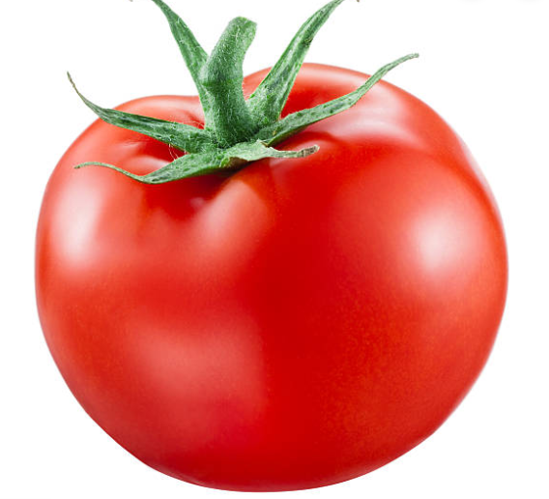
First 2 Strongest Rules:
Rule 1:
Rule 2:
+
+

Slide 14
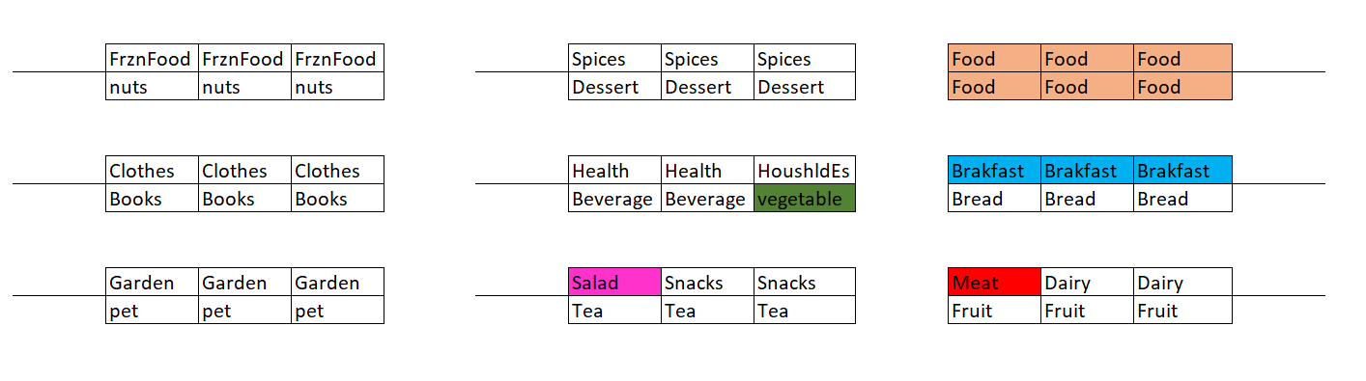
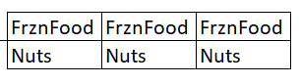
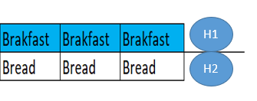
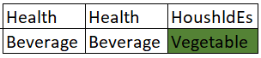
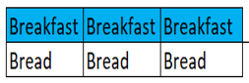
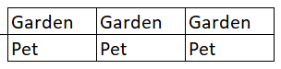
Current Location:
A1
D1
G1
A2
D2
G2
B1
E1
H1
B2
E2
H2
Rule2
C1
F1
I1
Rule1
C2
F2
I2

Slide 15
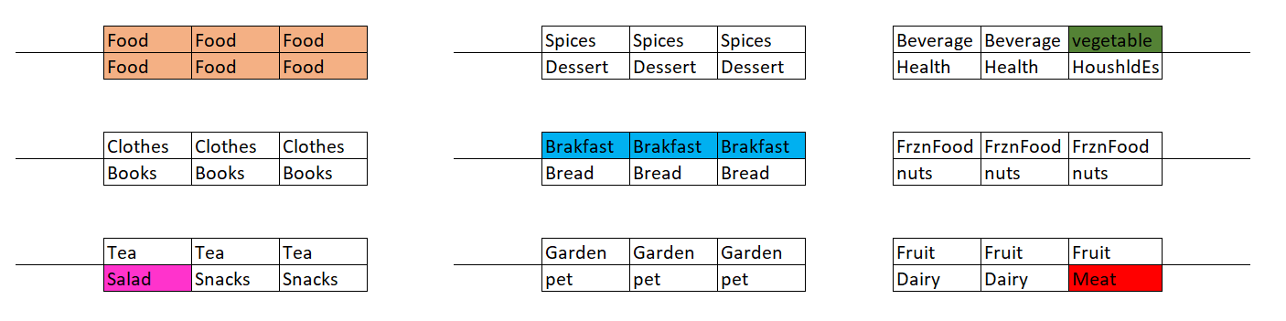
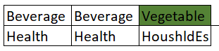
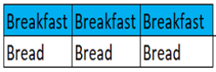
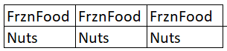
Optimum Location:
A1
D1
G1
A2
D2
G2
B1
E1
H1
B2
E2
H2
C1
F1
I1
C2
F2
I2
Rule 1
Rule 2

Slide 16
Current vs Optimum:
Every block in each aisle has average price.
Current Location:
When a customer walks through path of rule 1 and pick at least 1 item from each block he should pay $32.5. Also, if he walks through rule2 and pick 1 item from each block he should pay $42.5.
Optimum Location:
When a customer walks through path of rule 1 and pick at least 1 item from each block he should pay $97.5($65 more than current place) Also, if he walks through rule2 and pick 1 item from each block he should pay $87($54.5 more than current place).
Final Result:
Frequency of rule1 is 23 and frequency of rule2 is 33. So, if manager change the place of products like this project he can earn around $3277(23*65 +33*54=$3277 ) more money per week.

Slide 18
Current Location:
A1
D1
G1
A2
D2
G2
B1
E1
H1
B2
E2
H2
C1
F1
I1
C2
F2
I2

Slide 20
Vocabulary 1
1- out of the blue = without warning; unexpectedly.
"she phoned me out of the blue"
2- Commonality
3- [come across someone/something] to meet someone, or to find something by chance
4- one of the plausible explanation is that:
5- that is a plausible explanation might be case might not be the case but sounds reasonable
6- that comes from data

Slide 21
Vocabulary2
7- decide how to arrange products in the store
8- entice people to buy
9- separate as far as possible
10- have to walk through the whole store to pick up.
11- you see more other product
12- let’s talk about in more detail now.
13- people who bought also bought
14-potential rules
15- some rules are stronger some are weaker

Slide 22
Vocabulary3
16- we can come up with quite solid rules.
17-how apriori algorithm works : 3 parts : lift, support , confidence
18- confidence is defined as ….
19- lift is confidence divided by support
20- specific scenario
21- optimizing the sales
22- pop up in its mind
23- a basket of 3 products corn , milk and bread

Slide 23
Ideas
1-Buy bread and apple and …. From Walmart
2- give them to specific people and ask them to open the box
3- show the pictures of products on board
4- create new store in gilan based on the transaction and result in sari

Slide 24
Compare to Walmart pickup?
Why Walmart pickup does exist?

Slide 25
History of apriori & ARL
Commonality
What's the meaning of priori?
A priori, Latin for "from the former", is traditionally contrasted with a posteriori. ... Whereas a posteriori knowledge is knowledge based solely on experience or personal observation, a priori knowledge is knowledge that comes from the power of reasoning based on self-evident truths.

Slide 26
APriori algorithm (complete)
1-Step1: Set a minimum support and confidence
2-Step2: Take all the subsets in transactions having higher support than minimum support.
3-Step3: Take all the rules of this subsets having higher confidence than minimum confidence.
4-Step4: sort the rules by decreasing lift
Extra steps:
1-we need inspections to check our rules are Reasonable(relevant) or not how many rules does apriori algorithm find
2- identify the number of frequency

